Slide 1

Smart Agriculture System Based On IoT
Project Title : Smart Agriculture System Based On IoT
Project ID : SPS_PRO_101
Submitted By : Dnyanesh Kolhe (BE EXTC)
Submitted To : Intern Under Smartbride (Smartinternz)

Slide 2
Aim
To help farmer for easy farming
To get real time farm data such as Tempearture, Humidty & Soil moisture
Information about current weather forecast updates
Motor pump control from home or from any location

Slide 3
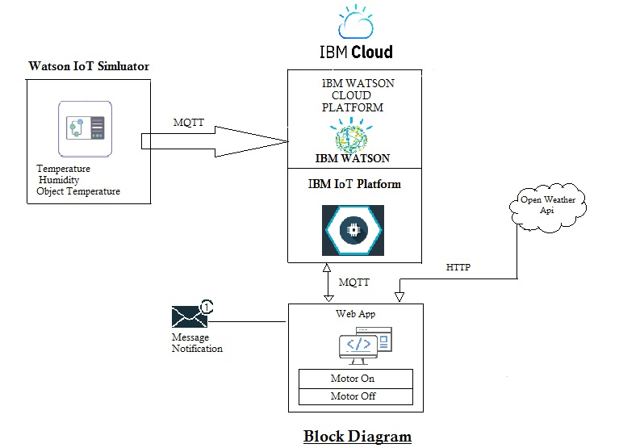
Development
Project is develop using nodered, IBM Bluemix Simulator and IBM Cloud IoT Platform
The data is received from IBM watson simulator and open weather api to node red and node red ui display result
Motor command is given from node red UI

Slide 4
Working
Two device is created in IBM IoT platform which is connected to Watson simulator or Bluemix simulator
Watson IoT simulator connected to the IBM platform display the sensor data
Two devices is created one for received sensor data and another is for motor control
For weather forecasting open weather API is used from openweathermaps.org to received current weather condition at particular place.
Python code is written for connecting motor. Motor control UI has two button for on/off operation

Slide 5
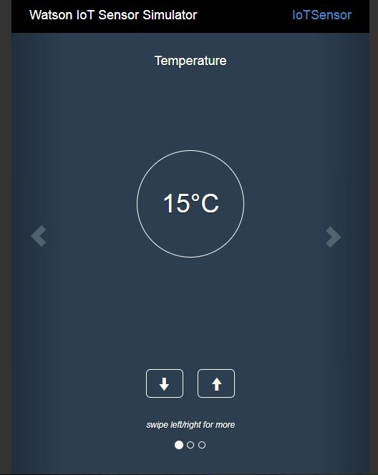
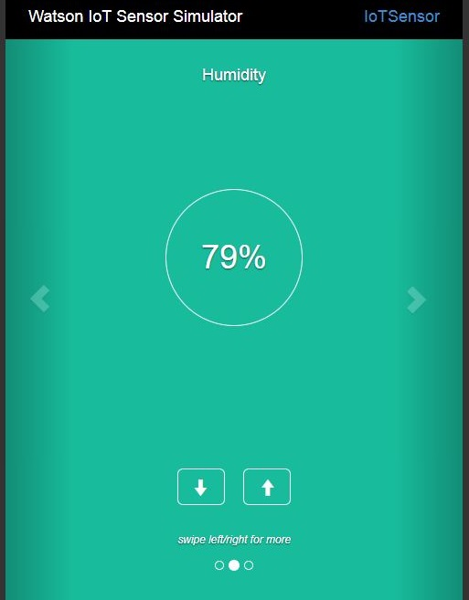
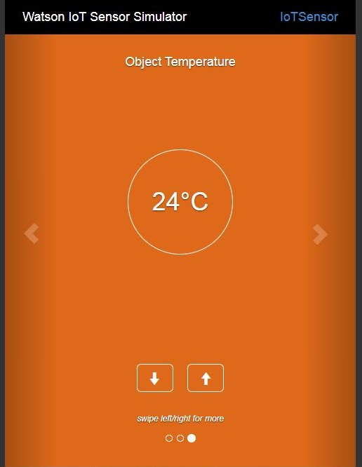
Node red is connected to display weather condition using the http request node and generated api key.
Node red UI consist of simulated sensor data, open weather and motor control button.

Slide 6
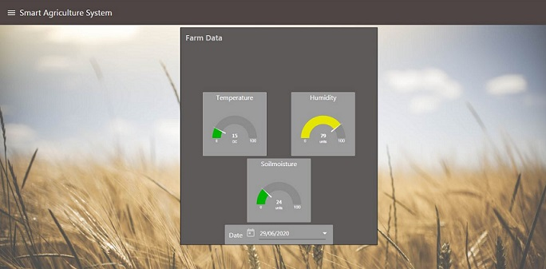
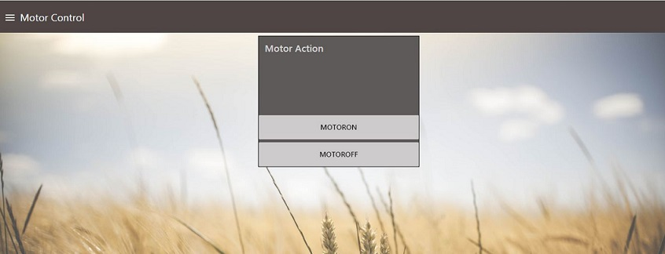
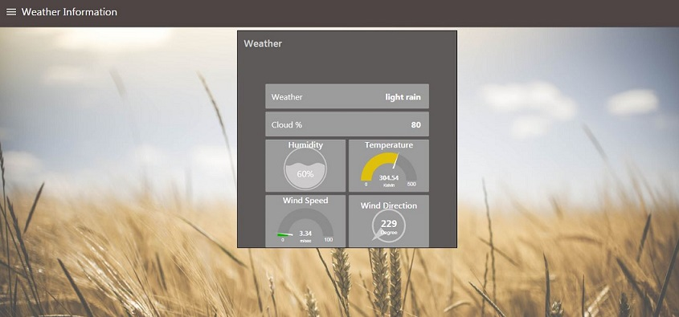
Web App

Slide 7
Conclusion
An application is developed user friendly which is esay to used .
It helps to moinitor real time soil condition
It helps farmer to monitor real time weather condition in nearby area
It is possible to control the water pump remotely from anywhere.
It is possible to used application in realtime.

Slide 8


Thank You !

